Slide 1
Explainable Artificial Intelligence
‘XAI’

Slide 2
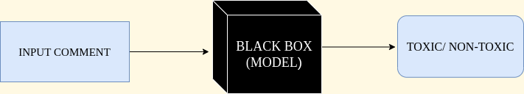
Need
Why did the model make a specific prediction or description
When did the AI system fail
Notes:
To understand the need for explanation there are certain questions to be asked … <Animate the questions> -- The failure to answer these questions turns the model into black box model
In black box method even the designers cannot explain why the AI arrived at specific decision
XAI aims at creating a suite of machine learning techniques that -
Produce explainable models while maintaining a high level of learning performance
Enable human users to understand, appropriately trust and effectively manage the emerging generation of artificially intelligent partners
XAI means humans can understand the path an IT system took to take the decision

Slide 3
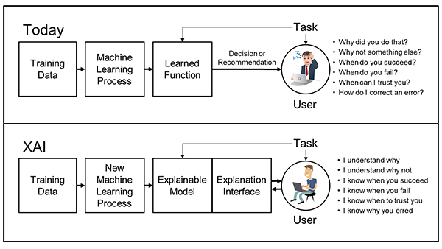
Concept
Notes:
The purpose of an explainable AI (XAI) system is to make its behavior more intelligible to humans by providing explanations
There are some general principles followed are-
The XAI system should be able to explain its capabilities and understandings
Explain what it has done, what it is doing now, and what will happen next

Slide 4
Ideal Model Classifier
Interpretable
Local Fidelity
Model Agnostic
Global perspective
Provide qualitative understanding between input variables and responses
Might not be possible for an explanation to be completely faithful unless it itself describes the model completely
Able to explain any model
Explain a representative set to user to give global intuition of the model
Notes:
Should be easy to understand
It must replicate the model’s behaviour in the vicinity of instance being predicted
Should not make any assumptions about model while providing explanations

Slide 5
Locally Interpretable Model-Agnostic Explanation

Slide 6
A python library which tries to solve for model interpretability by producing locally faithful explanations
LIME is a novel explanation technique that explains prediction of any classifier in an interpretable and faithful manner by learning an interpretable model locally around the prediction
Notes:
It is important to build trust in our model. There are simulations that give an aggregated view of model performance over unknown data. This does not help in understanding why some predictions are correct and some wrong. Also we cannot trace our model’s decision path i.e. we cannot figure out its learning or spurious conclusions. Now, if I tell you there exists a tool that explains model’s decision boundary in a human understandable way. This magical library is known as LIME.

Slide 7
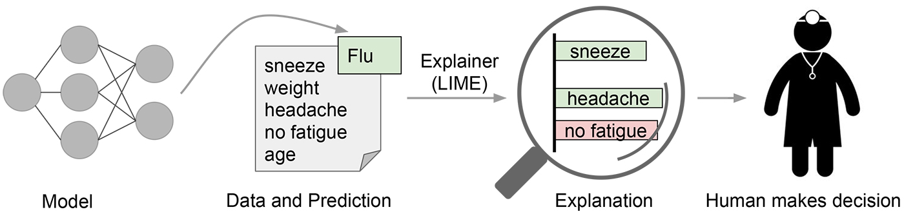
Notes:
The above mentioned example is significant in today’s scenario. We have a hospital where a number of patients are describing their symptoms. The doctor has refused to enter in lieu of pandemic and has left a compounder behind. Now the less qualified compounder is confused how to decide if the patients are to be sent to quarantine or not? He lists all their symptoms one by one and uses the magical tool to look up the symptoms with high resolution focus. The tool elaborates him about the common symptoms of the flu and a decision is made.
Here we have understand what type of decision is made. You would be curious to know how did LIME reached the explanation? We’ll find out as I roll along..

Slide 8
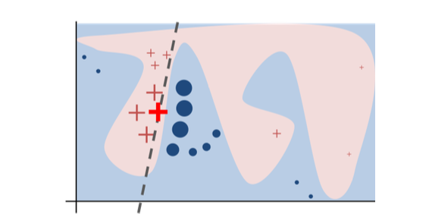
Working
The black box model’s complex decision function f is represented by the blue/pink background
The red cross is the instance being explained
The dashed line is the learned explanation that is locally faithful
Notes:
The background represents the decision function which cannot be approximated well by a linear model
LIME samples instances, gets predictions using function and then weighs them by the proximity to the instance being explained
It is important to note that the dashed line is locally faithful and not globally
Perform random uniform sampling from an interpretable representation and create multiple perturbed samples. These are then weighted by their probabilities, to summarize it can be said there is no dependency on the type of original model for LIME to provide explanations

Slide 9
LIME on Imbalanced data

Slide 10
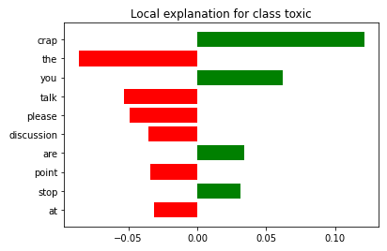
Logistic Regression
"Drappel, please stop reverting or read the god damned talk page, some medical practitioners..."" is weasel word crap, and the discussion of phentype is DIRECTLY contradicted in the following paragraph. I am not a vandal, but at this point you are."
[('crap', 0.12135146549087317), ('the', -0.08618127602306407), ('you', 0.062367789540932056), ('talk', -0.053072472438244186), ('please', -0.04913042520893451), ('discussion', -0.0356355724391451), ('are', 0.03423936508446596), ('point', -0.0340468183082469), ('stop', 0.031431635519624315), ('at', -0.0313282075101204)]
Notes:
It can be observed very clearly that LIME has correctly classified the toxic comments as well as the non toxic ones

Slide 11
LIME on balanced data

Slide 12
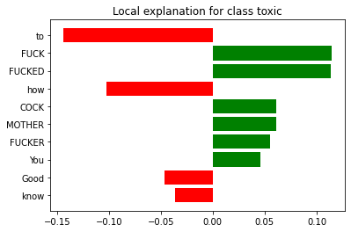
Random Forest Classifier
FUCK YOU Jdelanoy. You are German COCK SUCKER | FUCKER MOTHER FUCKER. Good to know how you FUCKED face looks.
[('crap', 0.12135146549087317), ('the', -0.08618127602306407), ('you', 0.062367789540932056), ('talk', -0.053072472438244186), ('please', -0.04913042520893451), ('discussion', -0.0356355724391451), ('are', 0.03423936508446596), ('point', -0.0340468183082469), ('stop', 0.031431635519624315), ('at', -0.0313282075101204)]
Notes:
It can be observed very clearly that LIME has correctly classified the toxic comments as well as the non toxic ones

